Slide 1
Files & File system

Slide 2

Open
Fd=open(pathname, flags, modes);
Pathname : file name
Flags : type of the open
Modes : file permission (esp for creat)
Returns an integer called the user file descriptor

Slide 3
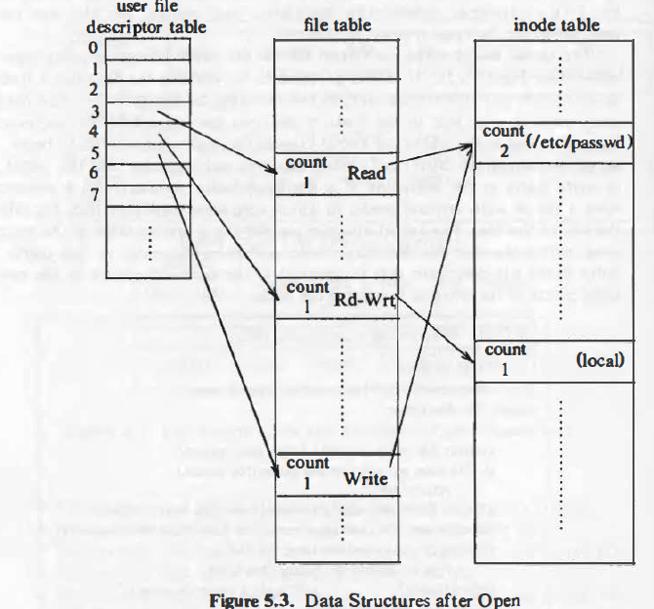
Data structures for open

Slide 4
Read
The syntax of the read system call is
number = read(fd, buffer, count)
-fd is the file descriptor returned by open
-buffer is the address of the data structure
-Count is the number of bytes the user wants to read
-number is the number of bytes actually read

Slide 5
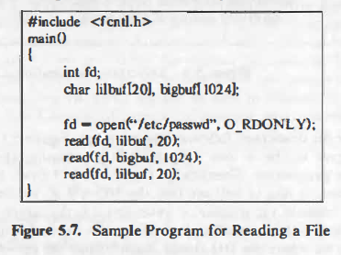

Slide 6
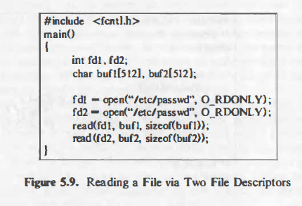

Slide 7
Write() system call
The syntax for the write system call is
number = write(fd, buffer, count);
where the meaning of the variables fd, buffer, count, and number are the same as they are for the read system call.
The algorithm for writing a regular file is imilar
to that for reading a regular file.

Slide 8
Creat()
the creat system call creates a new file in the system. The syntax for the creat system call is
fd - creat(pathname, modes) ;
where the variables pathname, modes, and fd mean the same as they do in the open system call.

Slide 9
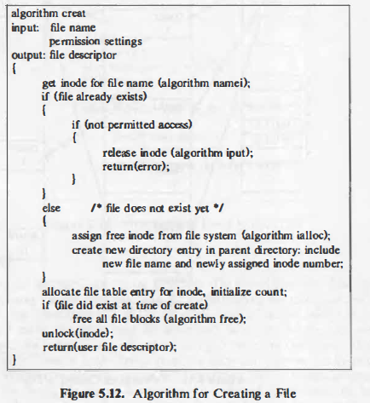

Slide 10
Close()
The syntax for the close system call is
close(fd);
where fd is the file descriptor for the open file.
The kernel does the close operation by manipulating the file descriptor and the corresponding file table and inode table entries. If the reference count of the file table entry is greater than 1

Slide 11
Cp program

Slide 12
Cp …

